Slide 1
Windows Administration
Telerik Software Academy
academy.telerik.com
Automating Windows Server
Borislav Varadinov
System Administrator
bobi@itp.bg

Slide 2

Table of Contents
What is PowerShell?
Shell vs Scripting
History of PowerShell
PowerShell Versions
PowerShell Today
Pipeline
PowerShell Modules and Snap-ins

Slide 3
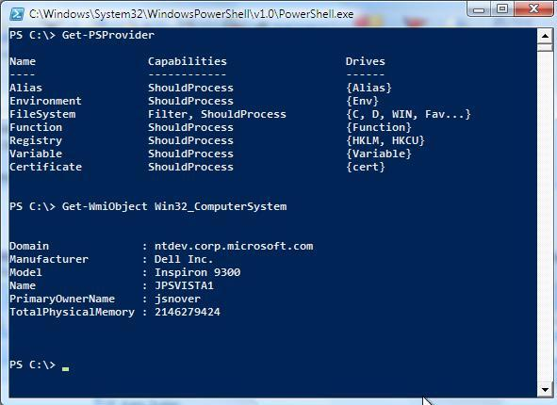
PowerShell
What is PowerShell?
Next generation of interactive shell
Extremely PowerFul automation framework
Scripting environment
Extensible and Modular scripting platform
Foundation to build GUI management
Easy to Learn
What is NOT PowerShell?
Programing Platform
Object Oriented Programing Language

Slide 4
Shell vs Scripting
Interactive as BASH/KSH
A shell is software that provides an interactive interface for users to access different services and components of the operating system.
Programmatic as Perl
A scripting language is a programming language that supports the writing of scripts or small programs that can automate the execution of tasks which could alternatively be executed one-by-one by a human operator.

Slide 5
I’m a really lazy person by nature
I’m a really lazy person by nature. I’m not lazy in the sense that I like to sit down and do nothing all day long, but rather I hate doing things over and over again. Whenever I find myself doing something very mundane, the first thing that pops into mind is “there has to be a way to automate this!”

Slide 6
History of PowerShell
Pre-1998 command.com and cmd.exe
1998 Introducing the Windows Script Host for Windows 98
2002 Microsoft started to develop the project Monad that will provide new approach to command line management
2005 the first Monad public beta release
2006 Monad had been renamed to Windows PowerShell
2006 PowerShell v1.0
2009 PowerShell v2.0
2012 PowerShell v3.0

Slide 7
PowerShell Versions
PowerShell V1
129 PowerShell cmdlets
COM
WMI
ADSI
ADO
XML
.NET
Native commands and text processing
PowerShell V2
Additional new Cmdlets
Improved ADSI, WMI, COM, XML, ADO, Background jobs
Advanced functions
PowerShell remoting
Script debugging
WS-MGMT
Web Services
ISE
PowerShell V3
Workflows
PowerShell Web Access
Scheduled Background jobs
Session connectivity
Improved code writing
Module Auto-Loading
Delegation support
Updatable help

Slide 8
Old World vs New World
:append
call :comment ":: %~n1">>"%libs_temp%"
%libs_cmd_copy% "%libs_temp%"+"%libs_path%\%~1" "%libs_temp%" >nul
goto :EOF
strComputer = "."
Set objWMIService = GetObject("winmgmts:" _
& "{impersonationLevel=impersonate}!\\" & strComputer & "\root\cimv2")
Set colProcesses = objWMIService.ExecQuery _
("Select * from Win32_Process Where Name = ‘notepad.exe'")
For Each objProcess in colProcesses
WScript.echo “ProcessName = ” & objProcess.Name
WScript.echo " ProcessID = ” & objProcess.ProcessID
Next
X
Windows PowerShell
PS C:\> Get-WmiObject -Query "select Name,ProcessID from Win32_Process where name='notepad.exe'"

Slide 9
Common Engineering Criteria
All Microsoft server products are required to comply with a set of engineering requirements as part of the Microsoft Common Engineering Criteria (CEC) program
The goal of the CEC program is to reduce the overall total cost of ownership (TCO) through improved integration, manageability, security, reliability, and other critical infrastructure attributes

Slide 10
Who uses PowerShell today?
Zimbra
Active Directory
IIS
Group Policy
Failover
Cluster
PowerShell
Exchange
Server
Best Practice Analyzer
Citrix
SQL
Server
Server
Manager
System Center
VMware

Slide 11
PowerShell Today
Installed by default in all Windows Server 2008 R2 and Server 2012 Editions
Installed by default in all Windows 7 and 8 Editions
Available as a Feature in Windows 2008 and Windows Vista
Available as extra download package for Windows Server 2003 and Windows XP

Slide 12
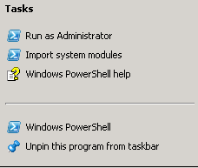
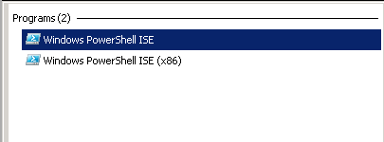

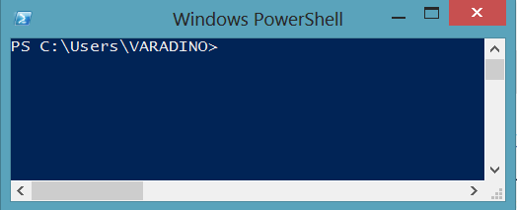
How to start PowerShell shell?

Slide 13
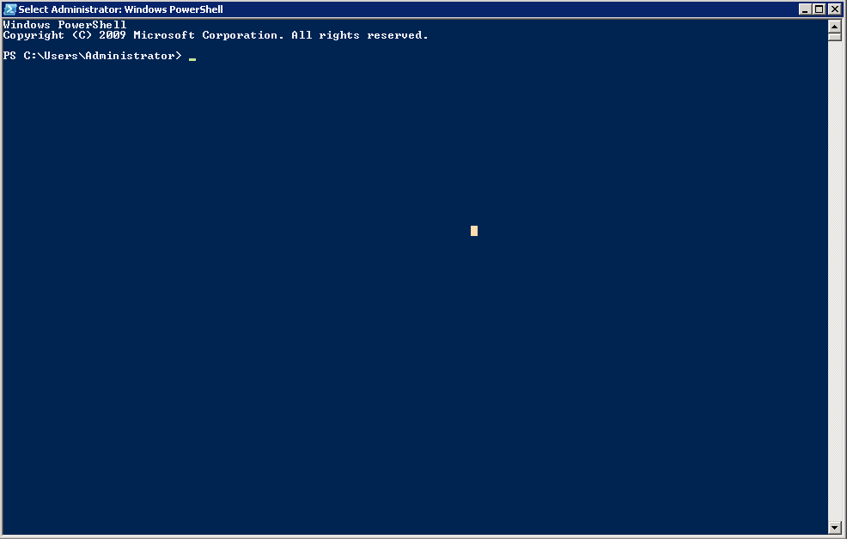
PowerShell Console

Slide 14
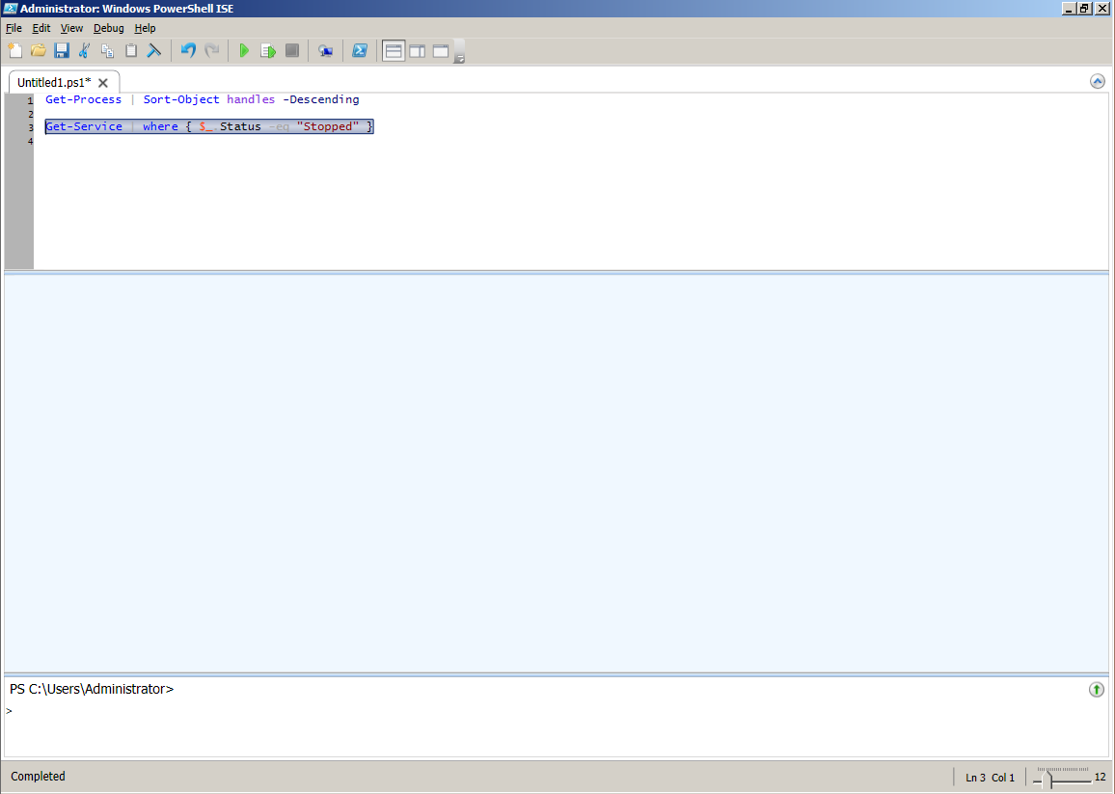
PowerShell ISE (Integrated Shell Environment)
Run Script
Run Selection
Script pane/Editor pane
Out Pane
Command Pane

Slide 15
PowerShell Cmdlets
In PowerShell, administrative tasks are generally performed by Cmdlets
Pronounced command-lets
Based on .NET Framework and its object model
You can use the magic button <TAB> for expansion

Slide 16
PowerShell Cmdlets Syntax
The Cmdlets follow a special naming pattern called verb-noun
Verb-Noun
Get-Service
Stop-Service
Restart-Service
Get-Verb
Remove or Delete
Find or Locate

Slide 17
Your best friends in PowerShell
Get-Command
Get-Help
Get-Member

Slide 18
Cmdlet Alias
Name | Cmdlet
Dir , ls | Get-ChildItem
Cd , md , rd | Set-Location, New-Item, Remove-Item
Ft – fl | Format-Table , Format-List
Where | Where-object
Foreach, % | Foreach-object
Gal | Get-alias
Gm | Get-Member
Gwmi | Get-WMIObject
….

Slide 19
Pipeline
The pipeline enables the output of one cmdlet to be piped as input to another cmdlet
Similar to Unix/Linux based shells
Differs from Unix/Linux based shells
Everything (almost) in PowerShell is Object
Cmdlets can pass data to each other as structured objects rather than a loose collection of text.
X
Windows PowerShell
PS C:\> Get-Content C:\Temp\Phones.txt | select-string 0896
0896 77 80 36 – Borislav Varadinov
PS C:\>

Slide 20
PSProviders and Get-PSDrive
Exposes system data as file system drive
Administrator navigates through system data using standard file system commands : cd – ls – dir
PSDrive | Usage
Alias: | List of PowerShell aliases
Function: | All available functions for the current session
Cert: | Access to the certificates store
Env: | List of system/user environment variables
Variable: | List of declared variables
HKCU: HKLM: | Access to registry

Slide 21
Console Input and Output
Write-Host
Write-Host “Hello World” –ForegroundColor Green
Write-Host “Hello World” –BackgroundColor 10
Read-Host
Read-Host "Please enter your name"
Colors
DarkGreen
DarkCyan
DarkRed
DarkMagenta
DarkYellow
Gray
DarkGray
Blue
Green
Cyan
Red
Magenta
Yellow
White
Black
DarkBlue

Slide 22
All those legacy commands
PowerShell recognizes some of the common CMD or Unix shell commands
They are implemented internally with Aliases
The parameters of the commands may not be the same as the original
PowerShell works also with the external console programs
X
Windows PowerShell
PS C:\Temp>ls
Directory: C:\Temp
Mode LastWriteTime Length Name
---- ------------- ------ ----
-a--- 2/19/2013 2:08 PM 14 Object.txt
PS C:\Temp> ls -l
Get-ChildItem : Missing an argument for parameter 'LiteralPath'. Specify a parameter of type 'System.String[]' and try again.
At line:1 char:4
+ ls -l
Ls -> Get-ChildItem
X
Windows PowerShell
PS C:\Temp> ipconfig /all | findstr "Servers"
DNS Servers . . . . . . . . . . . : 192.168.1.1

Slide 23
PowerShell Modules and Snap-ins
Snap-ins and Modules are packages that extends the shell with additional functionality for particular products or technologies
You can think about them as similar to the MMC’s snap-ins
Snap-ins - the "old way" of extending PowerShell
Have to be installed and registered in the operating system
Can contain: Cmdlets and Providers
Still used for some technologies: E.g. SharePoint 2010 Cmdlets
Modules - introduced in PowerShell v2.0
Don't need to be installed (just copy them)
Can contain: Cmdlets, Providers, Functions, Workflows, Variables, and Aliases
Script Modules

Slide 24
Automating Windows Server
http://academy.telerik.com

Slide 25
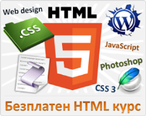



Free Trainings @ Telerik Academy
"Web Design with HTML 5, CSS 3 and JavaScript" course @ Telerik Academy
html5course.telerik.com
Telerik Software Academy
academy.telerik.com
Telerik Academy @ Facebook
facebook.com/TelerikAcademy
Telerik Software Academy Forums
forums.academy.telerik.com

